Slide 1
Zoom Games
Embrace The Chaos
Sarah Johnson, Ethan Kohrt, Jake LaMotte, Boone Tison

Slide 2
Introduction
Research Question: Is there an untapped area for gaming in videoconferencing software?
Motivation: Enrich socialization on videoconferencing software using integrated games that can mimic the in-person experience of playing games with friends and family
Argument: There is a clear market for integrated games on platforms, such as Zoom. Our results indicate interest in games that can be quickly played with a small group, both in contexts like socialization, but also during down time in meetings or lectures.
Ethan

Slide 3
Background
Literature Review
2007 study, “Mafia” over videoconferencing software had similar levels of enjoyment as in-person play (Batcheller, 2007).
Three-player pong, leveraged separation of players for experience (Mueller, 2006).
Long-distance family connections using videoconferencing software, software suggestions for playing with children (Follmer, 2010).
Competitive Analysis
“Caribu” app – games or storybooks with children over a video call
Games played via videoconferencing with minor adjustments
Ethan

Slide 4
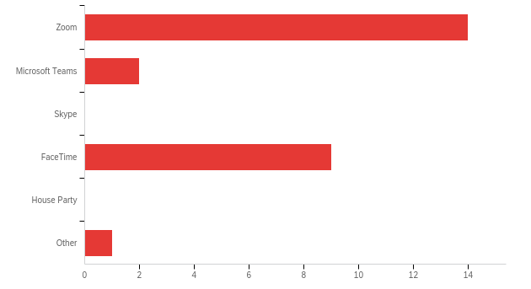
Requirements Analysis
Survey of 14 questions with 26 responses
College students and faculty
Results:
Interested in videoconferencing games: (84.6%)
Most popular contexts were “socializing with friends,” “virtual events,” and “school”
Duration of games: 2-3 minutes (66.7%), 30 second turn-based (23.8%)
Size of games: 3+ people (66.7%)
Most used software: Zoom (53.8%), FaceTime (34.6%)
Image Source: [1]
Boone

Slide 5
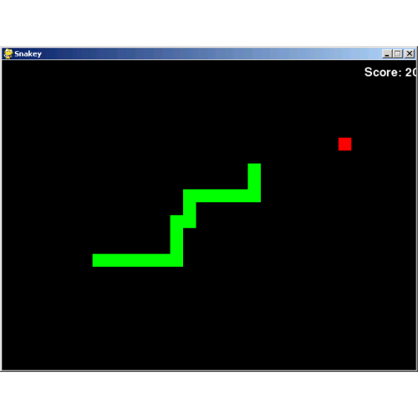
Requirements Analysis
Semi-structured interviews with three participants
Ideal group size of 3-5 people
Ideal duration is short, around 5 minutes
Generally bored during meetings
Looked elsewhere for entertainment, such as games
Image Source: [2]
Boone

Slide 6
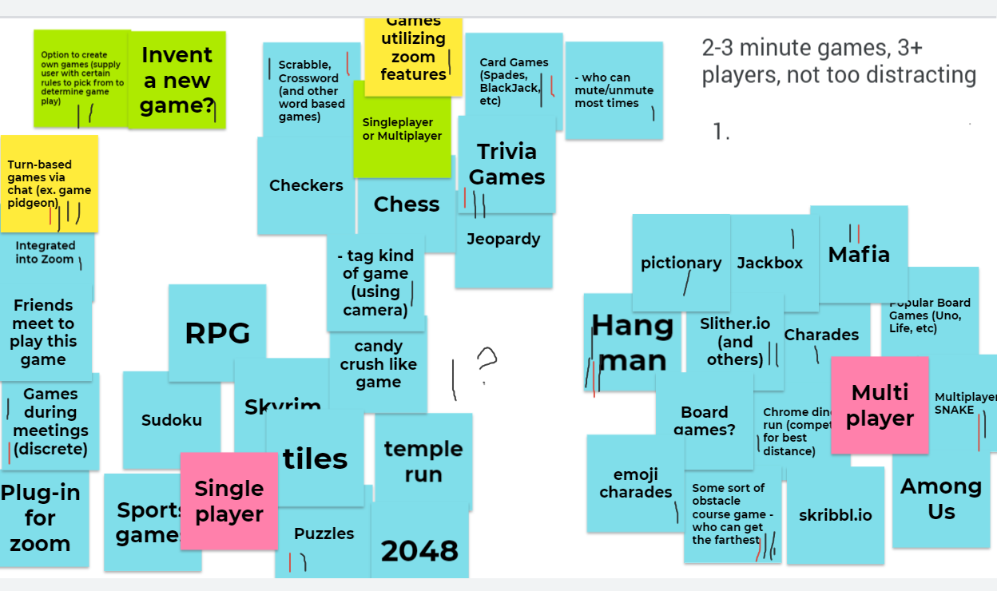
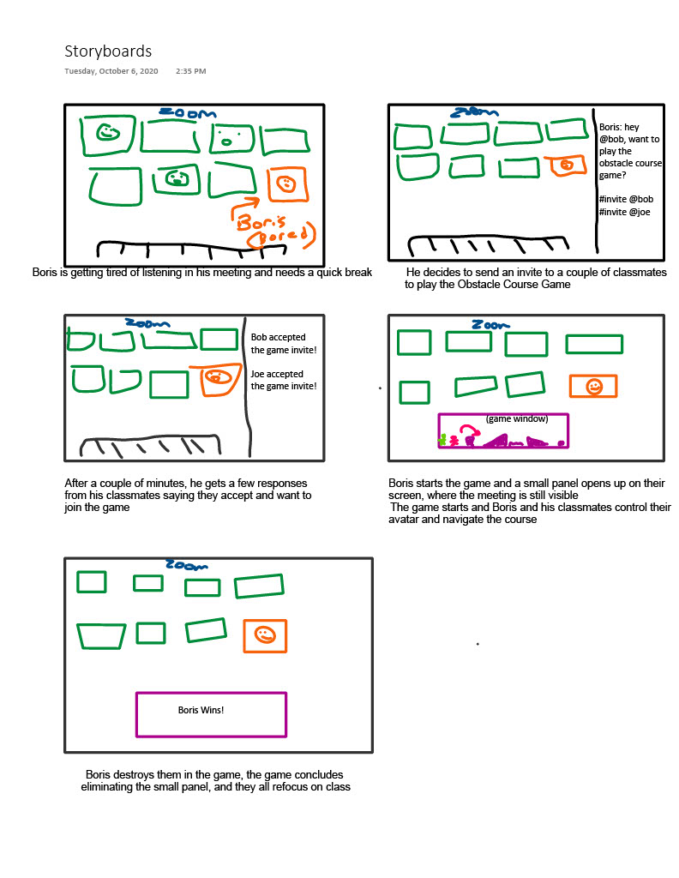
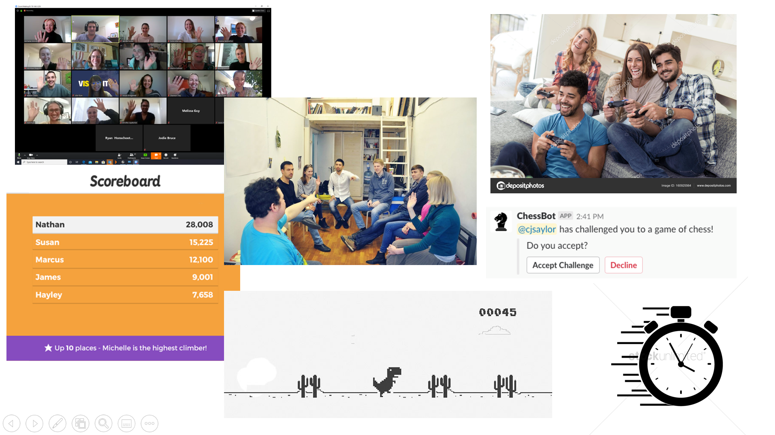
ideation
Jake

Slide 7
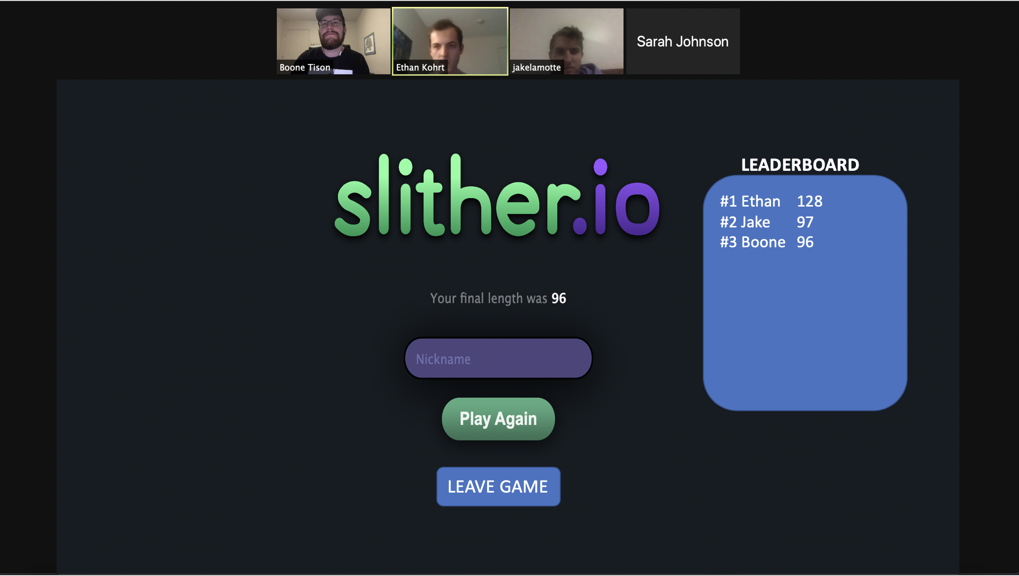
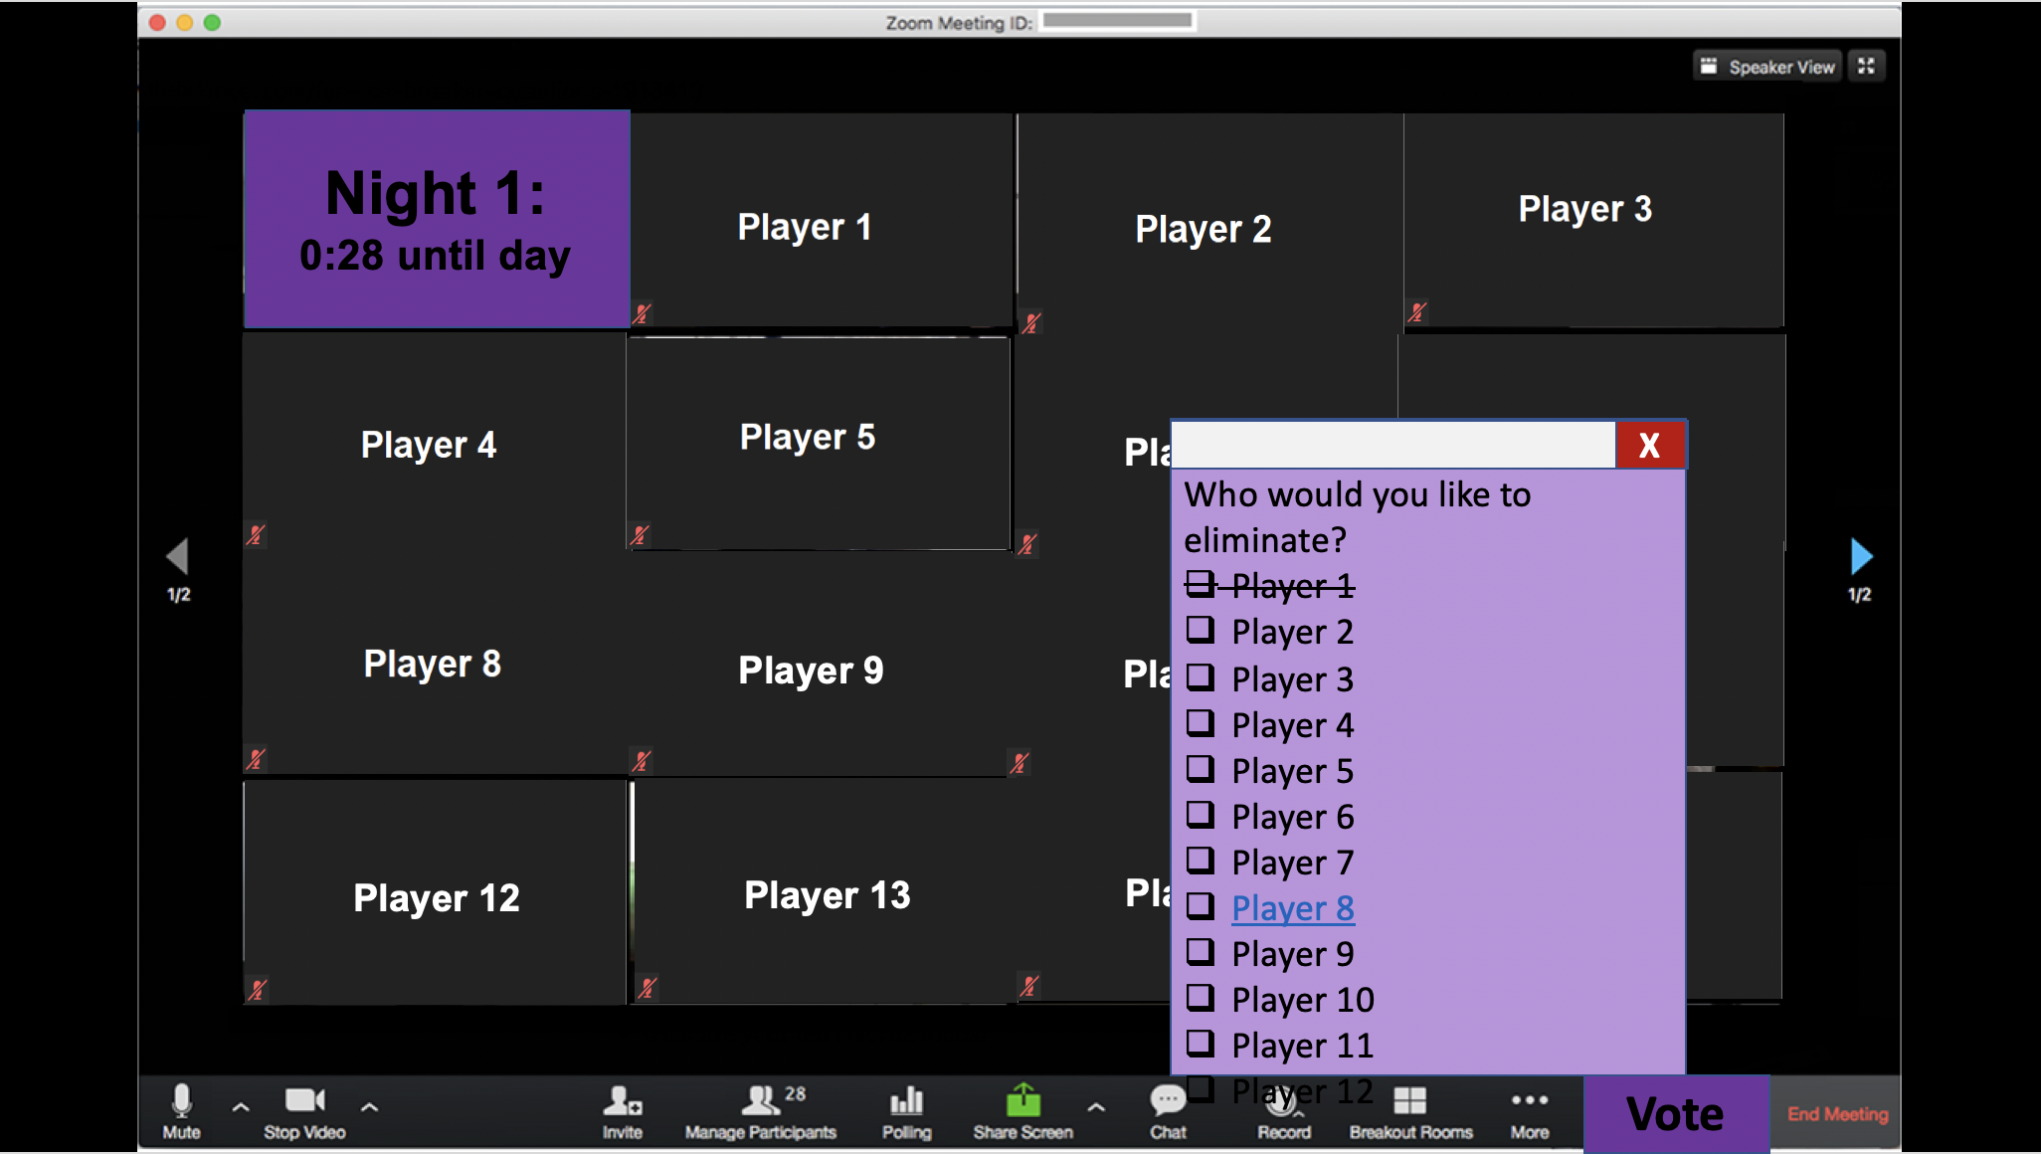
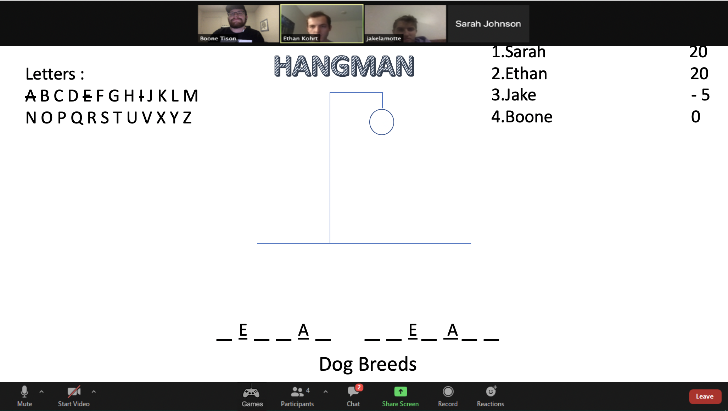
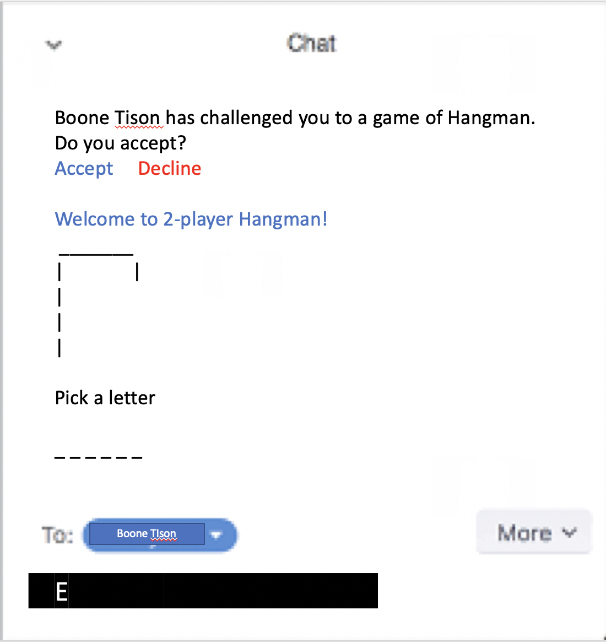
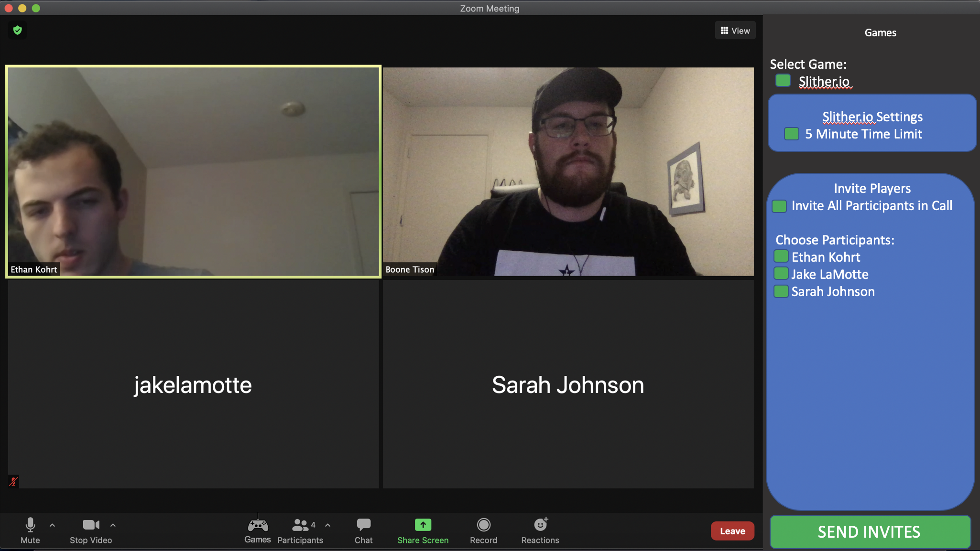
Low fidelity prototypes
Jake

Slide 8
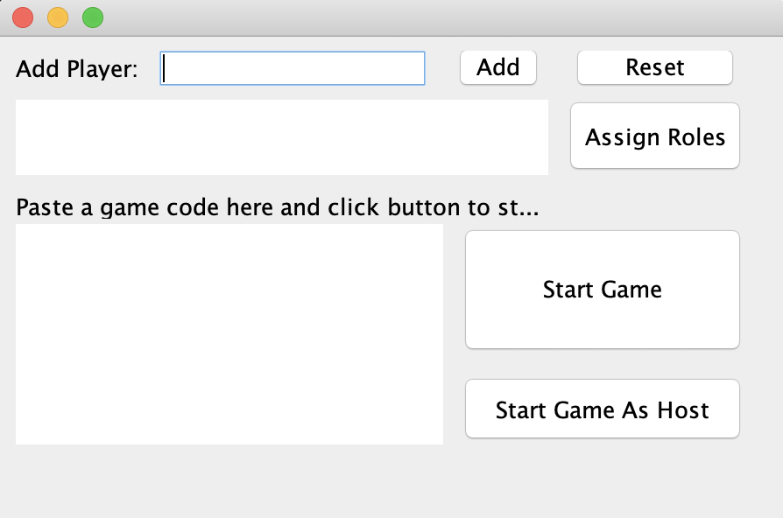
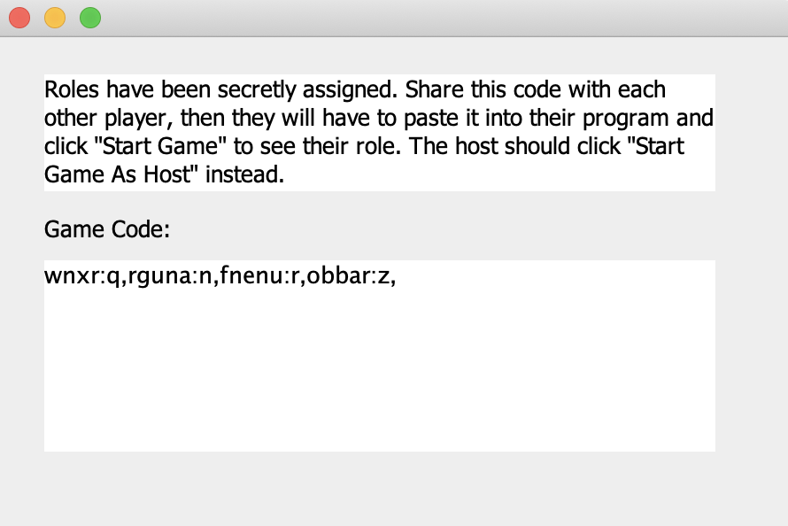
High fidelity prototype
Ethan

Slide 9
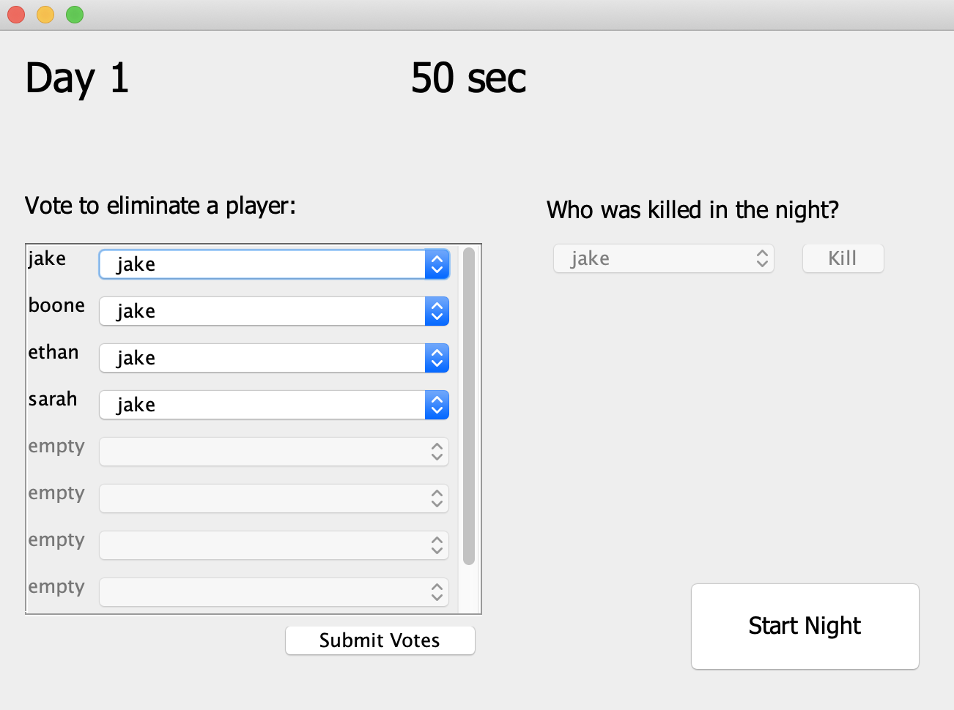
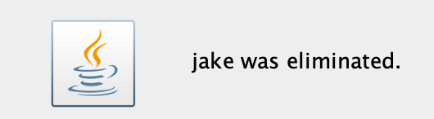
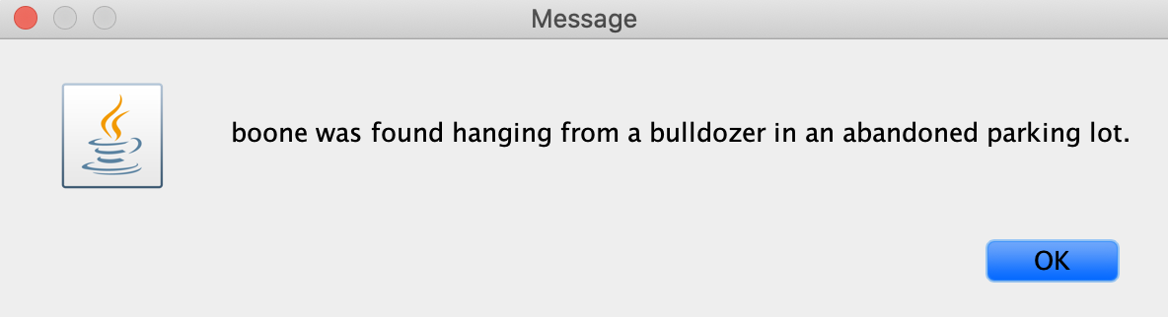

High fidelity prototype
Ethan

Slide 10
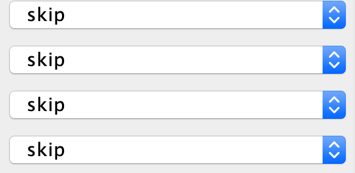
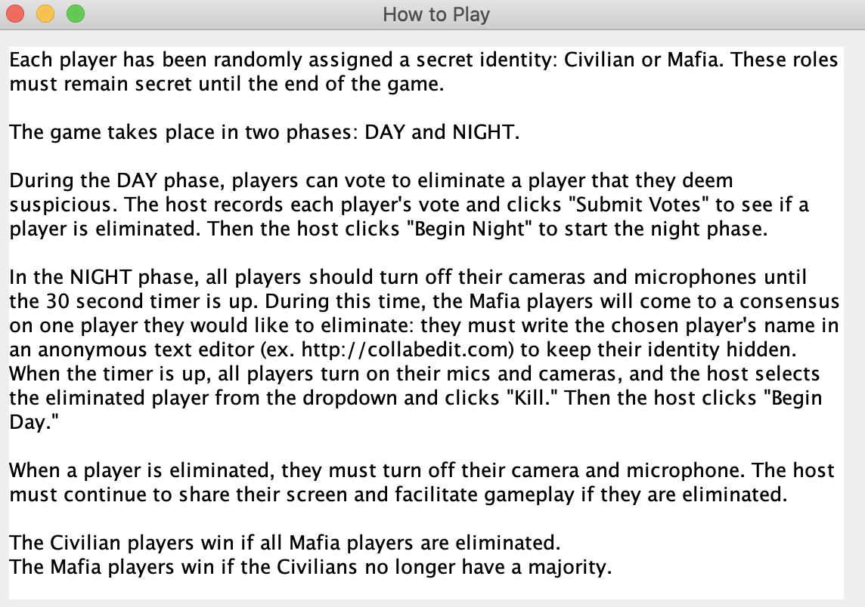
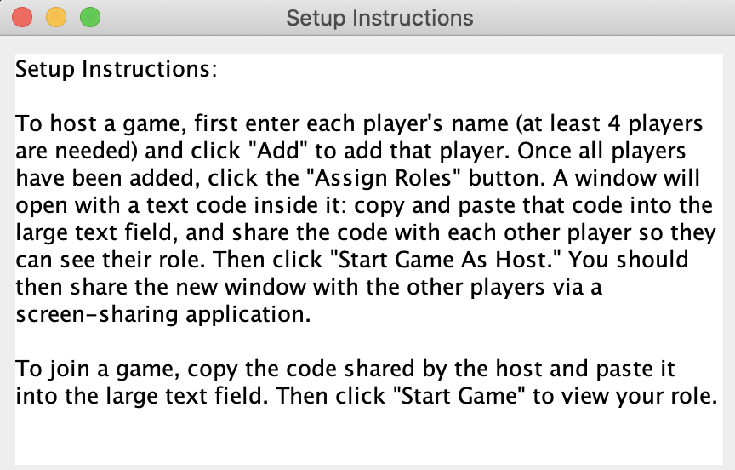
Changes from heuristic evaluation
Default voting choice:
Tutorials
Boone

Slide 11
User evaluation
Played through test run of game with participants
4 participants, one at a time
Semi-structured interview
Questions:
1.Rate on a scale of 1–5 how fun the prototype was to play, with 5 being very fun.
2.What were the features you liked the most about the prototype?
3.What features do you think should be eliminated or included in the prototype? Why should these features be eliminated or included?
4.Was the prototype easy to operate? Were you confused at any point during the game and if so where?
5.Would you play this game with your friends? Why or why not?
Sarah

Slide 12
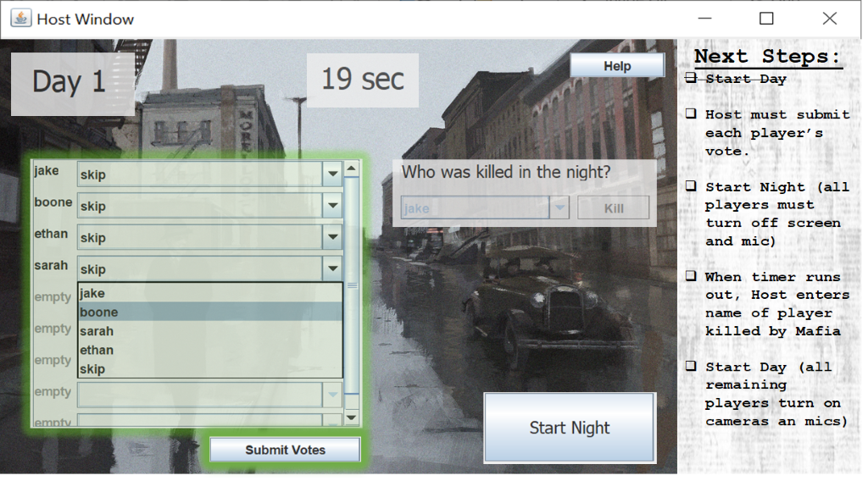
Results from User evaluation
Average rating of 4 on a scale of 1-5
Favorite features
Anonymous chat and death text
Features to add:
Visual cues to highlight next action user should take
Thematic visuals such as drawn characters or icons
Features to fix:
Some thought intentions were not clear during setup of new game
Sarah

Slide 13
Works cited
Batcheller, Archer L., Brian Hilligoss, Kevin Nam, Emilee Rader, Marta Rey-Babarro, and Xiaomu Zhou. “Testing the Technology: Playing Games with Video Conferencing.” In Proceedings of the SIGCHI Conference on Human Factors in Computing Systems - CHI ’07. ACM Press, 2007. https://doi.org/10.1145/1240624.1240751.
Follmer, Sean, Hayes Raffle, Janet Go, Rafael Ballagas, and Hiroshi Ishii. “Video Play.” In Proceedings of the 9th International Conference on Interaction Design and Children - IDC ’10. ACM Press, 2010. https://doi.org/10.1145/1810543.1810550.
Mueller, Florian “Floyd,” and Martin Gibbs. “A Table Tennis Game for Three Players.” In Proceedings of the 20th Conference of the Computer-Human Interaction Special Interest Group (CHISIG) of Australia on Computer-Human Interaction: Design: Activities, Artefacts and Environments - OZCHI ’06. ACM Press, 2006. https://doi.org/10.1145/1228175.1228234.

Slide 14
Image sources
1. https://www.qualtrics.com/
2. https://veryutils.com/snake-classic-python-game-template

